Slide 1
Java Essentials
By: Santosh

Slide 2
Contents
Java Basics
OOPS
String
Access Modifiers in Java
Constructors
Exception Handling
Collection APIs

Slide 3
Java Basics
Features
Datatypes
Primitive and Non-Primitive
Type Conversion
Implicit and Explicit
Operators
Control Statements
Array (1D and 2D)

Slide 4
Feature
Java is an object-oriented language.
Originally developed by James Gosling at Sun Microsystems (which is now a subsidiary of Oracle Corporation) and released in 1995.
Platform Independent
Portable
Robust and Safe

Slide 5
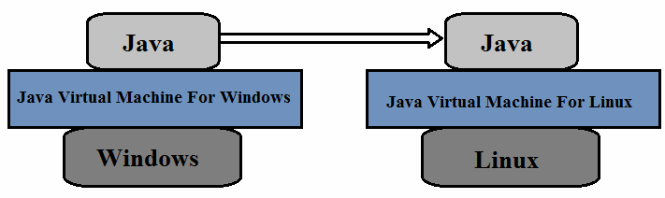
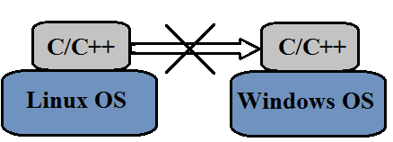
Portability
As long as there is a JVM compiled for that particular processor and OS.

Slide 6
Safe
No pointer (no direct access to memory)
Automatic garbage collection
Check array access bound

Slide 7
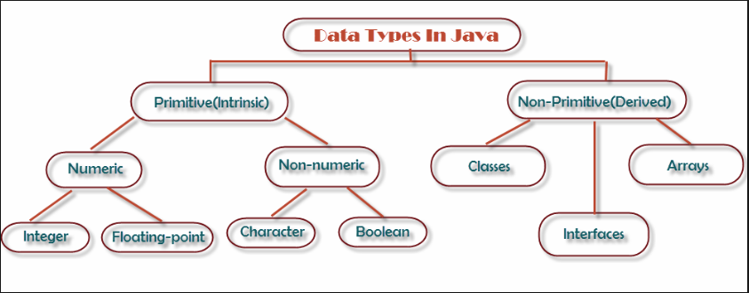
Datatypes

Slide 8
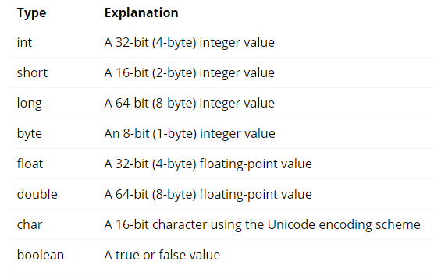
Primitive Datatypes
Java defines eight primitive datatypes

Slide 9
Primitive Datatypes
Declaration
byte a = 20;
short b = 22;
int c = 34567;
long l = 34905857;
float e = 324.5f; / 324.5F;
double g = 2234.5; / 2234.5d; / 2234.5D;
char h = ‘a’;
boolean = true; / false;

Slide 10
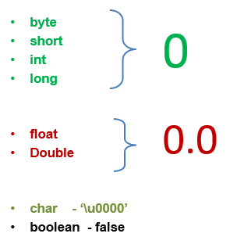
Primitive Datatypes
Default Value

Slide 11
Primitive Datatypes
Type Conversion
byte → short → int → long (implicitly)
byte ← short ← int ← long (Explicit casting)
float → double (implicit)
float ← double (explicit)
boolean(Cannot be casted)

Slide 12
Primitive Datatypes
Implicit Casting
byte c = 120;
short d = c;
Explicit Casting
short c = 234;
byte d = (byte)c;
(We need to explicitly mention to cast)

Slide 13
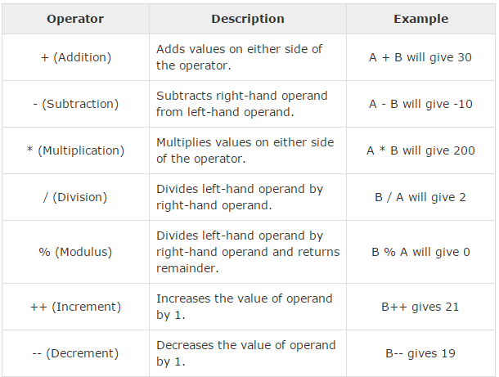
Operators
Arithmetic Operators
Assume:
int a = 10;
int B = 20;

Slide 14
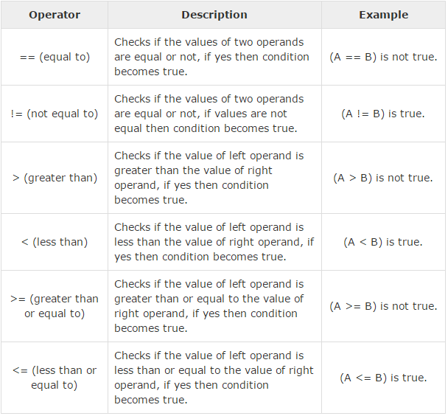
Operators
Relational Operators

Slide 15
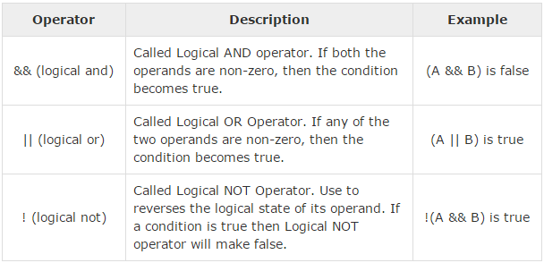
Operators
Logical Operators
boolean A = true;
boolean B = false;

Slide 16
Java Control Statement
if else
switch
while
do while
for
break
continue
return

Slide 17
Java Control Statement
If-else
if(conditional_statement){
statement to be executed if conditions becomes true
}else{
statements to be executed if the above condition becomes false
}

Slide 18
Java Control Statement
While-loop
while(condition_statement→true){
Statements to be executed when the condition becomes true and execute them repeatedly until condition becomes false.
}
E.g.
int x =2;
while(x>5){
system.out.println(“value of x:”+x);
x++;
}

Slide 19
Java Control Statement
Do while – loop
do{
statements to be executed at least once without looking at the condition.
The statements will be exeucted until the condition becomes true.
}while(condition_statement);

Slide 20
Java Control Statement
for – loop
for (initialization; condition; increment/decrement) {
statements to be executed until the condition becomes false
}
E.g:
for(int x=0; x<10;x++){
System.out.println(“value of x:”+x);
}

Slide 21
Java Control Statement
break
Break is used in the loops and when executed, the control of the execution will come out of the loop
for(int i=0;i<50;i++){
if(i%13==0){
break;
}
System.out.println(“Value of i:”+i);
}

Slide 22
Java Control Statement
continue
Continue makes the loop to skip the current execution and continues with the next iteration.
for(int i=0;i<50;i++){
if(i%13==0){
continue;
}
System.out.println(“Value of i:”+i);
}

Slide 23
Java Control Statement
return
return statement can be used to cause execution to branch back to the caller of the method.

Slide 24
Arrays
Collection of similar data types
Stages
Declaration
Construction
Initialization

Slide 25
Arrays
Declaration
Declaring Arrays:
int[] marks;
byte[] age;
Less readable:
int marks[];
byte age[];

Slide 26
Arrays
Construction
int[] marks;
marks = new int[5];
“The size of the array is mandatory”
In single line:
int[] marks = new int[5];
marks

Slide 27
Arrays
Initialization
Initialization is loading the array with the values.
int[] marks = new int[5];
marks[0] =20;
marks[1]=49;
marks[2] =30;
marks[3] = 67;
marks[4] = 35;
20
49
30
67
35

Slide 28
Arrays
Two Dimensional Array
int[][] marks = new int[2][3]
marks[0][0] = 30;
marks[0][1]=31;
marks[0][2]=32;
marks[1][0]=40;
marks[1][1]=41;
marks[1][2]=42;
0
1
30
31
32
40
41
42

Slide 29
Arrays
Drawbacks
Arrays are of fixed size.
Can hold only same data type variables.

Slide 30
OOPS Concepts

Slide 31
OOPS
Concepts
Class and its members
Methods and Variables
Object
Features (IPEA)

Slide 32
OOPS
Object Oriented Programming is a paradigm that provides many concepts such as inheritance, data binding, polymorphism etc.
The programming paradigm where everything is represented as an object, is known as truly object-oriented programming language.
Simula is considered as the first object-oriented programming language.

Slide 33
OOPS
Class and its members
Class is a Fundamental unit of Java program and Blueprint of an object.
All java programs are classes.
Each class define a unique kind of object ( a new data type).
Each class defines a set of fields, methods or other classes.*
File name must be the same as one of the class names, including capitalization.
A class describes a set of objects that have identical characteristics (data elements) and behaviours (methods).
Existing classes provided by JRE
User defined classes
Once a class is established, you can make as many objects of it as you like, or none.

Slide 34
OOPS
Example of a class:
public class Circle{
int radius; //member variable
int area; //member variable
void area(){ //member method
area = 3.14 * radius * radius;
}
}

Slide 35
OOPS
Object
Object is a thing
Object is an instance of a class.
An object has state, behaviour and identity
Internal variable : store state
Method : produce behaviour
Unique address in memory : Object identity is typically implemented via a unique ID. The value of the ID is not visible to the external user. But, it is used internally by the JVM to identify each object uniquely.
For Example: Pen is an object. Its name is Reynolds, colour is white etc. known as its state. It is used to write, so writing is its behaviour.

Slide 36
OOPS
Simple Example of Object and Class
In this example, we have created a Student class that have two data members id and name. We are creating the object of the Student class by new keyword and printing the objects value.
class Student {
int id=77; //data member (also instance variable)
String name=“XXXXXX”;//data member(also instance variable)
public static void main(String args[]){
Student s=new Student();//creating an object of Student
System.out.println(s.id+" "+s.name);
}
}
Output: 77 XXXXXX

Slide 37
OOPS
Object Reference
Example :
Class Car {
int speed=100;
}
Car c= new Car();
Here ‘c’ is a reference variable which is pointing to a Car object. ‘c’ will hold the memory address to reach out the Car object.

Slide 38
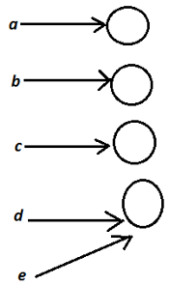
OOPS
Car a= new Car();
Car b= new Car();
Car c= new Car();
Car d= new Car();
Car e= d;
d.speed=60;
System.out.println(e.speed);
Output : 60

Slide 39
OOPS
Object Instantiation and Initialization
Person p; // Instantiation: only created the reference, not an object. It points to nothing now (null).
p = new Person(); //Initialization: create the object (allocate storage in memory), and p is initialized.
Person p = new Person(); // Instantiation and Initialization together
p.name = “Simon”; //access the object through the reference

Slide 40
OOPS
Method in detail:
Methods are members of a class.
Methods have the behaviour of class object.
Variants for a method :
Methods without parameter
Methods with parameter
Methods that return something
Methods that don’t return anything (void)

Slide 41
OOPS
1. Method without parameter
void printName(){
system.out.println(“I am XXXXXXXXXX”);
}
2. Method with parameter
void getArea(int side){
Area = side*side;
}

Slide 42
OOPS
3. Method that return something
Date getCurrentDate(){
return Calender.get(Calender.DAY_OF_MONTH);
}
4. Method that doesn’t return anything
void printDate() {
System.out.println(Calender.get(Calender.DAY_OF_MONTH));
}

Slide 43
OOPS
Method creation concept:
accessModifier returnType methodName(argumentType argumentValue, ….){
//methodBody
}
Eg.
public int getSquare(int side){
return side*side;
}

Slide 44
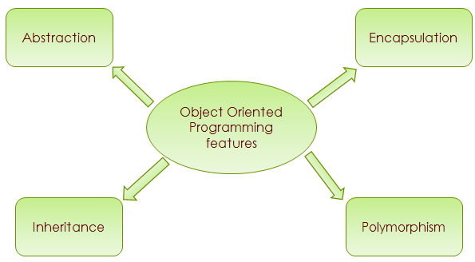
OOPS
Feature

Slide 45
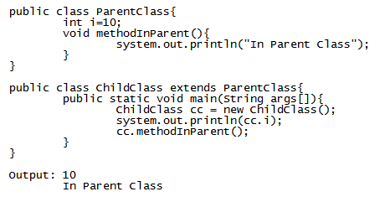
OOPS
Inheritance
When one object acquires all the properties and behaviours of parent object i.e. known as inheritance. It provides code reusability.
In Java it is achieved by “extends” keyword

Slide 46
OOPS
Polymorphism
Polymorphism word comes from ancient Greek where poly means many so polymorphic are something which can take many form. i.e. something which can depicts different meaning depending on the context it is put in. Like the English word run means differently in these two context :
run computer, run business
Polymorphism is the ability to create a function has more than one form.
In java, polymorphism is divided into two parts : method overloading and method overriding.
Another term operator overloading is also there, e.g. “+” operator can be used to add two integers as well as concat two sub-strings. Well, this is the only available support for operator overloading in java, and you can not have your own custom defined operator overloading in java.

Slide 47
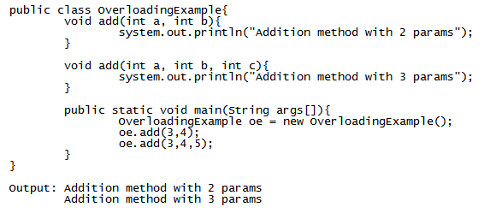
OOPS
Polymorphism: method overloading
If a class have multiple methods by same name but different parameters, it is known as Method Overloading.
If we have to perform only one operation, having same name of the methods increases the readability of the program.
There are two ways to overload the method in java :
By changing number of arguments
By changing the data type

Slide 48
OOPS
Polymorphism: method overriding
If subclass has the same method as declared in the parent class, it is known as method overriding.
Rules for Method Overriding :
method must have same name as in the parent class
method must have same parameter as in the parent class.
must be IS-A relationship (inheritance).

Slide 49
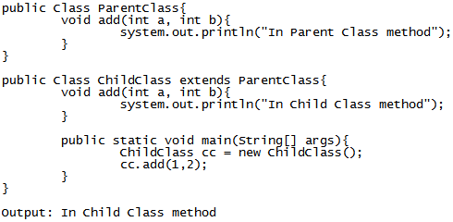
OOPS
Overriding Example

Slide 50
OOPS
Overloading against Overriding
Method Overloading
Method overloading is used to increase the readability of the program.
method overloading is performed within a class.
In case of method overloading parameter must be different.
Method Overriding
Method overriding is used to provide the specific implementation of the method that is already provided by its super class.
Method overriding occurs in two classes that have IS-A relationship.
In case of method overriding parameter must be same.

Slide 51
OOPS
Abstraction
In Object Oriented Approach, Abstraction means showing the what is implemented without showing how it is implemented
Eg:
When you start or stop a server you just give the command of starting and stopping. Here you only know that server has implementation of Start and Stop functionalities but you don’t know about how these two functionalities are implemented.
Java provides abstraction with below two mechanism:
1. Abstract Class
2. Interface

Slide 52
String
Strings are a sequence of characters.
In the Java programming language, strings are objects.
Java platform provides the String class to create and manipulate strings.
String is immutable.
Creating String in java. :
String greeting ="Hello world!";
String say = new String(“Hello World”);

Slide 53
String
Functions of String:
int length() Returns the length of this string.
String[] split(String regex) Splits this string around matches of the given regular expression.
String toLowerCase() Converts all of the characters in this String to lower case using the rules of the default locale.
String toUpperCase() Converts all of the characters in this String to upper case using the rules of the default locale.
String trim() Returns a copy of the string, with leading and trailing whitespace omitted.

Slide 54
Access Modifiers in JAVA
Access Modifiers helps to implement the concept of encapsulation in OOPs (data hiding).
Access Modifiers affect the accessibility at 2 levels :
Class level
Members level (methods and instance variables)
Member Level Access Modifiers
public, private, default and protected
Class Level Access Modifiers
public and default

Slide 55
Access Modifiers in JAVA
Access Modifier at Class level: public
When a class is marked as public , its visible to world (all classes inside and outside packages).
Import statement is needed to access public class of another package.
No need of import statement when class is accessed in the same package.

Slide 56
Access Modifiers in JAVA
Access Modifier at Class level: default
Default access has no keyword.
When there are no Access Modifiers declared , the access is default level access.
When a class is marked with default access, its visible to all classes inside the same package only.

Slide 57
Access Modifiers in JAVA
Access Modifier at Member level: public
A member with public access is visible to all the classes inside and outside the package.
The class in which the member exists should be visible to the accessing class.
- Check if the class itself is visible

Slide 58
Access Modifiers in JAVA
Access Modifier at Member level: protected
A member marked as protected is visible to all the classes inside the same package.
Protected members are also accessible to classes outside the package , but the accessing class should be a sub-class of the member class.
It should be accessed in inheritance way*.

Slide 59
Access Modifiers in JAVA
Access Modifier at Member level: private
When a member is marked as private, it is only visible inside the same class.
Other classes inside and outside the package will not be able to access the private members of the class.

Slide 60
Access Modifiers in JAVA
Access Modifier at Member level: default
Default access has no keyword.
When there are no Access Modifiers declared , the access is default level access.
When a member is marked with default access, its visible to all classes inside the same package only.

Slide 61
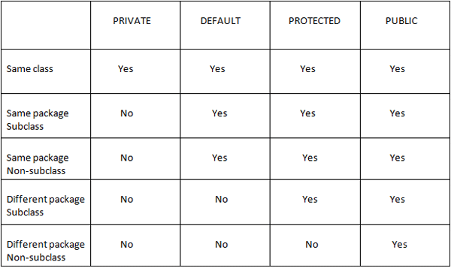
Access Modifiers in JAVA
Cheat Sheet

Slide 62
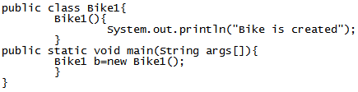
Constructors
Constructor in java is a special type of method that is used to initialize the object.
Two rules for the constructor.
Constructor name must be same as its class name
Constructor must have no explicit return type
Two types of Constructor
Default constructor (no-arg constructor)
Parameterized constructor

Slide 63
Constructor
This and Super keyword
this:
this keyword refers to current class.
super:
super refers to immediate base(parent) class.

Slide 64
Exception Handling
Exception: Any unwanted/undesired event that cause termination of execution of program, is called Exception.
Exception handling is not meant as repairing the exception, instead it is the approach of providing alternative way to continue the execution of program normally.*
Exception is handled with below approach:
Try-catch block
Throws keyword

Slide 65
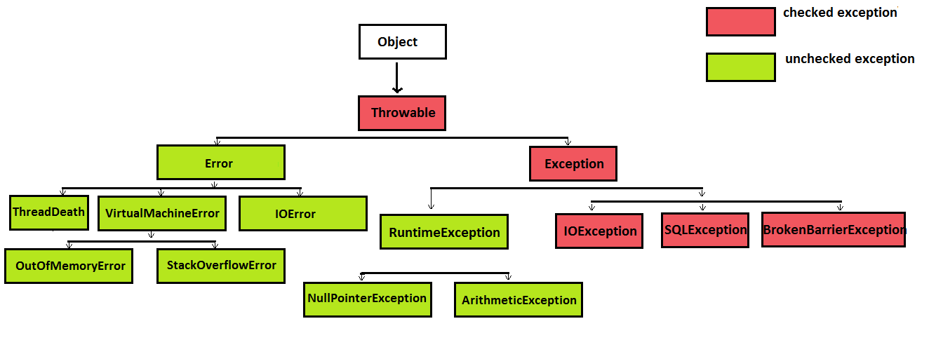
Exception Handling
Exception Hierarchy

Slide 66
Exception Handling
Checked Exception vs Unchecked Exception
Checked Exception: The exception which are checked by compiler for smooth execution of program are called Checked Exception. Eg. fileNotFoundException etc.
In our program if there is a chance of rising checked exception then compulsory we should handle the checked exception (Either by try catch or by throws keyword) otherwise we will get compile time error.
Unchecked Exception: The exceptions which are not checked by compiler whether programmer handling or not such type of exception are called unchecked exception. Eg. ArithmeticException etc.
Note: Whether it is checked or unchecked, every exception occurs at runtime only. There is no chance of occurring any exception at compile time.

Slide 67
Exception Handling
Exception and Error
Exception: Most of the time exceptions are caused by our program and these are recoverable (by writing try catch block). For example, if our programing req is reading data from remote file locating at London, if at runtime remote file is not available then we ll get runtime exception saying file not found exception. If file not found exception occurs we can provide local file and continue rest of the program normally.
Error: Most of times error are not caused by our program and these are due to lack of system resources. Errors are non-recoverable. For eg. If outOfMemory error occurs, being a programmer we can’t do anything and program will be terminated abnormally. System admin or server admin is responsible to increase heap memory.

Slide 68
Exception Handling
Try, Catch, Finally block
The code which might throw some exceptions should be kept in try and catch block.
The catch block can have the code to handle the exception or log the same.
finally block can be used to clean up code or release some resources that are utilized in the program.
It is recommended to use finally block however it is not mandatory. We can handle the exception using only try and catch block.*

Slide 69
Exception Handling
Syntax
try {
// code that might cause problem
}catch( Exception e) {
//when Exception occurs control comes here
} finally {
// Release some resources here
//this block is optional
// will always be executed
}

Slide 70
Exception Handling
Points to keep in mind:
When there is a try block , catch or finally block should be there.
There should not be any statements between try, catch and finally.
There can be multiple catch() blocks
There should be only 1 finally block for any try block.
Catch() is executed only when an Exception is thrown.
When an Exception is thrown the rest of the lines of code in try block will not get executed and control directly goes to catch() of finally.
Exceptions occurs only at runtime, during the program execution.

Slide 71
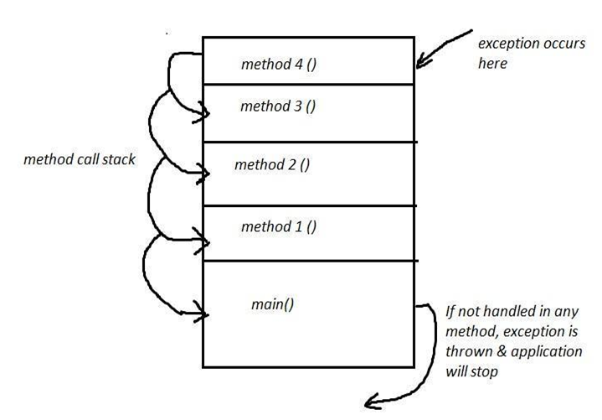
Exception Handling
Execution propagation

Slide 72
Exception Handling
throws keyword:
We can use throws keyword to delegate responsibility of exception handling to the caller (caller may be another method or jvm) then caller method is responsible to handle that exception.
Example :
public void readFile () throws FileNotFoundException {
………………….
}

Slide 73
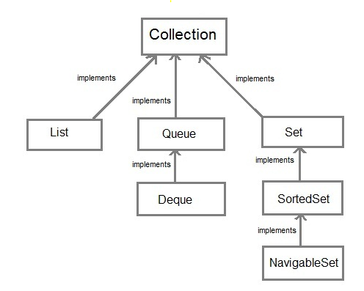
Collection APIs
Collection represents a series of objects in a single unit.
Collections are just like arrays, but they are dynamic unlike arrays.
Collection framework provides many interfaces (Set, List etc.) and classes (ArrayList, HashSet etc).

Slide 74
Collection APIs
Important methods of Collection Interface
public boolean add(Object element)
is used to insert an element in this collection.
public int size()
return the total number of elements in the collection.
public boolean remove(Object element)
is used to delete an element from this collection.
public boolean contains(object element)
is used to search an element.
public Iterator iterator()
returns an iterator.
public Object[] toArray()
converts collection into array.
public boolean isEmpty()
checks if collection is empty.

Slide 75
Collection APIs
Important Classes of Collections framework
ArrayList
ArrayList<String> list = new ArrayList<String>();
HashSet
HashSet<String> set = new HashSet<String>();

Slide 76
Collection APIs
ArrayList Class
It implements List interface.
Uses a dynamic array for storing the elements .
Can contain duplicate elements.
Maintains insertion order.
Random access because array works at the index basis.

Slide 77
Collection APIs
HashSet Class
It implements Set interface.
Contains unique elements.
Does not maintains insertion order.

Slide 78
Collection APIs
Iterator Interface
Iterator interface provides the facility of iterating the elements in forward direction only.
Methods of Iterator interface
There are only three methods in the Iterator interface.
public boolean hasNext() it returns true if iterator has more elements.
public object next() it returns the element and moves the cursor pointer to the next element.
public void remove() it removes the last elements returned by the iterator. It is rarely used.

Slide 79
Collection APIs
How to create Iterator in Java
Every collection classes provides an iterator() method that returns an iterator to the beginning of the collection. By using this iterator object, we can access each element in the collection, one element at a time.
In general, to use an iterator to traverse through the contents of a collection follow these steps:
1. First obtain an iterator to the beginning of the collection by calling the collection's iterator( )
2. Set up a loop that makes a call to hasNext( ). Have the loop iterate as long as hasNext( ) returns true.
3. Within the loop, obtain each element by calling next( ).

Slide 80
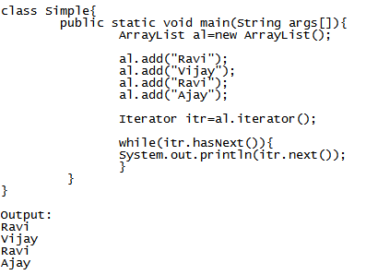
Collection APIs
Example:

